Slide 1
CSE-3109 Computer Architecture
Lecture 2
Performance

Slide 2
Defining Performance
If you were running a program on two different desktop computers, you’d say that the faster one is the desktop computer that gets the job done first.
If you were running a datacenter that had several servers running jobs submitted by many users, you’d say that the faster computer was the one that completed the most jobs during a day.

Slide 3

Data Center
A data center, sometimes spelled as datacenter (one word), is the name given to a facility that contains a large number of computer servers and related equipment.

Slide 4
Cont.
As an individual computer user, you are interested in reducing response time—the time between the start and completion of a task—also referred to as execution time.
This includes disk accesses, memory accesses, I/O activities, operating system overhead, CPU execution time, etc.

Slide 5
Cont.
Datacenter managers are often interested in increasing throughput the total amount of work done in a given time.
Decreasing response time almost always improves throughput.

Slide 6

Cont.
To maximize performance, we want to minimize response time or execution time for some task. Thus, we can relate performance and execution time for a computer X:

Slide 7
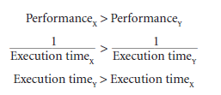
Cont.
This means that for two computers X and Y, if the performance of X is greater than the performance of Y, we have
That is, the execution time on Y is longer than that on X, if X is faster than Y.

Slide 8

Cont.
In discussing a computer design, we often want to relate the performance of two different computers quantitatively. We will use the phrase “X is n times faster Than Y”.

Slide 9

Cont.
If X is n times faster than Y, then the execution time on Y is n times longer than it is on X:

Slide 10

Example
If computer A runs a program in 10 seconds and computer B runs the same program in 15 seconds, how much faster is A than B?
Solution
We know that A is n times faster than B if

Slide 11



Solution-Cont.
Thus the performance ratio is
In the above example, we could also say that computer B is 1.5 times slower than computer A, since
means that

Slide 12
Measuring Performance
Time is the measure of computer performance: the computer that performs the same amount of work in the least time is the fastest.
Program execution time is measured in seconds per program.
However, time can be defined in different ways, depending on what we count.

Slide 13
Measuring Performance
The most straightforward definition of time is called wall clock time, response time, or elapsed time.
These terms mean the total time to complete a task, including disk accesses, memory accesses, input/output (I/O) activities, operating system overhead—everything.

Slide 14
Program or CPU Execution time
CPU execution time is the total time a CPU spends computing on a given task. It also excludes time for I/O or running other programs. This is also referred to as simply CPU time.

Slide 15
CPU Execution time
CPU time- 1. User CPU time
2. System CPU time
CPU time spent in the program is called User CPU time and the CPU time spent in the operating system performing tasks requested by the program is called System CPU time.

Slide 16
CPU Execution time
Suppose, after executing a program we get the following measurements:
User CPU time – 90.7 seconds
System CPU time – 12.9 seconds
Elapsed time – 159 seconds

Slide 17
Unload
In the world of computing, unload is a term used to describe the process of removing one process from another. For example, when a TSR is loaded into memory, it can be unloaded from memory by closing or end in task manager.

Slide 18
TSR
Short for terminate-and-stay-resident, a TSR is a software program that remains in memory until it is needed, and then performs some function. An example of a TSR is an antivirus scanner, which must remain loaded in memory to help protect your computer from computer viruses.

Slide 19
Task Manager
The Task Manager is an operating system component found in all versions of Microsoft Windows since Windows NT 4.0 and Windows 2000. It allows you to view each of the tasks (processes) and the overall performance of the computer. Using the Task Manager, you can view how much memory a program is using, stop a frozen program, and view available system resources.

Slide 20
System Performance and CPU performance
The term system performance is used to refer to elapsed time on an unloaded system
CPU performance refers to user CPU time on an unloaded system.

Slide 21

Clock Cycle
Almost all computers are constructed using a clock that that regulates the speed at which it executes instructions and also synchronizes it with other components. The speed at which the microprocessor executes instructions is called clock speed. Designers refer to the length of a clock period as the time for a complete clock cycle (e.g., 250 picoseconds, or 250 ps)
The clock rate (e.g., 4 gigahertz, or 4 GHz), is the inverse of the clock period.

Slide 22
Clock Cycle: Analogy of Synchronization
Imagine a music conductor tapping a beat with a baton (a stick) at regular intervals. Suppose you are playing a piano, and you're told to play a new note each time he taps his baton. Thus, how fast the conductor taps the baton controls how often you play notes.

Slide 23
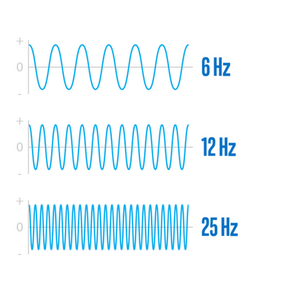
Analogy of Synchronization
In a computer, the clock cycle is the time between two adjacent pulses of the oscillator that sets the tempo of the computer processor.
But for our purposes, they’re a basic unit that helps understand a CPU’s speed. During each cycle, billions of transistors within the processor open and close.

Slide 24
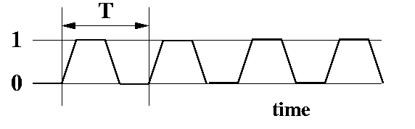
A realistic Clock Cycle
A clock can't really instantaneously go from 0 to 1 and back to 0. A more realistic diagram looks like:

Slide 25
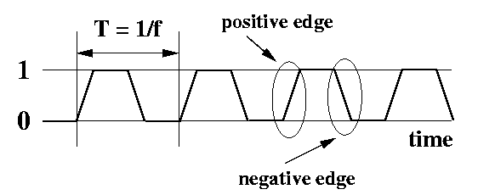
Features of a Clock
period This is the time it takes for a clock signal to repeat. Its unit of measurement is seconds. The symbol for the period is T.
frequency is 1/T. This is also sometimes called Hertz (abbreviated Hz). Sometimes people say "cycles per second" instead of Hz . They all mean the same. When people refer to the "speed" of a CPU, they are usually talking about the clock frequency.

Slide 26
Features of a Clock
positive edge When the signal transitions from 0 to 1. It's circled above.
negative edge When the signal transitions from 1 to 0. It's circled above. Each positive clock edge appears once per clock period. Each negative clock edge appears once per clock period.

Slide 27
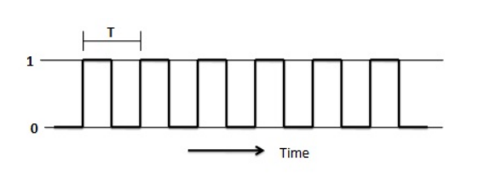
Clock Signal in Sequential Circuit
The clock signal plays a crucial role in sequential circuits. A clock is a signal, which oscillates between logic level 0 and logic level 1, repeatedly. Square wave with constant frequency is the most common form of clock signal. A clock signal has “edges”. These are the instants at which the clock changes from 0 to 1 (a positive edge) or from 1 to 0 (a negative edge).

Slide 28
Clock Signal in Sequential Circuit
Clock signals control the outputs of the sequential circuit .That is it determines when and how the memory elements change their outputs . If a sequential circuit is not having any clock signal as input, the output of the circuit will change randomly. So that they cannot retain their state till the next input signal arrives. But sequential circuits with clock input will retain its state till the next clock edge occurs.

Slide 29
Can’t we make CPU faster with faster clock?
If a CPU will run faster with a faster clock, then why not run it faster? The problem is that it takes time for signals to move around in a circuit. You can reduce this time in several ways. The main way is simply to make the circuit smaller. When the circuit is smaller, signals have less distance to travel, and therefore everything can happen more quickly.

Slide 30


CPU Performance and Its Factors
CPU time for a program can be expressed in two ways:
Alternatively, because clock rate and clock cycle time are inverses,
This formula makes it clear that the hardware designer can improve performance by reducing the number of clock cycles required for a program or the length of the clock cycle.

Slide 31
Example
Our favourite program runs in 10 seconds on computer A, which has a 2 GHz clock. We are trying to help a computer designer build a computer, B, which will run this program in 6 seconds. The designer has determined that a substantial increase in the clock rate is possible, but this increase will affect the rest of the CPU design, causing computer B to require 1.2 times as many clock cycles as computer A for this program. What clock rate should we tell the designer to target?

Slide 32
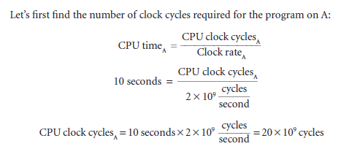
Solution

Slide 33
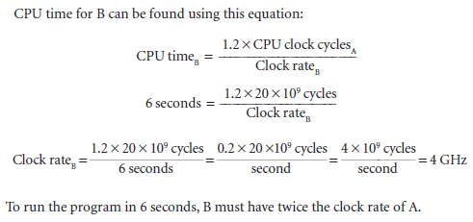
Solution

Slide 34

Instruction Performance
Since, The computer had to execute the instructions to run the program, the execution time must depend on the number of instructions in a program.
One way to think about execution time is that it equals the number of instructions executed multiplied by the average time per instruction.
Therefore, the number of clock cycles required for a program can be written as

Slide 35
Instruction Performance
The term clock cycles per instruction, which is the average number of clock cycles each instruction takes to execute, is often abbreviated as CPI.
Since different instructions may take different amounts of time depending on what they do, CPI is an average of all the instructions executed in the program.
CPI provides one way of comparing two different implementations of the same instruction set architecture, since the number of instructions executed for a program will, of course, be the same.

Slide 36
Example
Suppose we have two implementations of the same instruction set architecture. Computer A has a clock cycle time of 250 ps and a CPI of 2.0 for some program, and computer B has a clock cycle time of 500 ps and a CPI of 1.2 for the same program.
Which computer is faster for this program and by how much?

Slide 37


Solution
We know that each computer executes the same number of instructions for the program; let’s call this number I. First, find the number of processor clock cycles for each computer:
Now we can compute the CPU time for each computer:

Slide 38


Solution
Likewise, for B:
Clearly, computer A is faster. The amount faster is given by the ratio of the execution times:
We can conclude that computer A is 1.2 times as fast as computer B for this program.

Slide 39


CPU Execution Time
We have,
Also,
We can now write this basic performance equation in terms of instruction count (the number of instructions executed by the program), CPI, and clock cycle time:

Slide 40

CPU Execution Time-Cont.
or, since the clock rate is the inverse of clock cycle time:

Slide 41

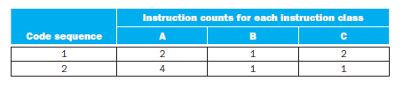
Example
A compiler designer is trying to decide between two code sequences for a particular computer. The hardware designers have supplied the following facts:
For a particular high-level language statement, the compiler writer is considering two code sequences that require the following instruction counts:
Which code sequence executes the most instructions? Which will be faster? What is the CPI for each sequence?

Slide 42

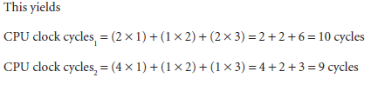
Solution
Sequence 1 executes 2 + 1 + 2 = 5 instructions.
Sequence 2 executes 4 + 1 + 1 = 6 instructions.
Therefore, sequence 1 executes fewer instructions.
So code sequence 2 is faster, even though it executes one extra instruction.

Slide 43
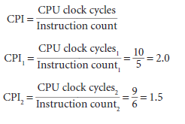
Solution

Slide 44
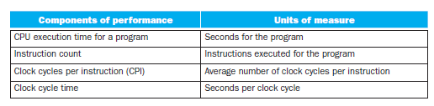

Summary

Slide 45
End

